Slide 1


OBJECT ORIENTED PROGRAMMING THROUGH JAVA

Slide 2

L13-METHODS IN JAVA

Slide 3


Slide 4
What is a method?:
A method is a collection of statements that perform some specific operation or task and return the result.
The main advantage of methods is code reusability
Method can be identified by parenthesis i.e. If any name which associate with ‘’parenthesis’’ () is called a method.
Ex: public void method()
{
---
---
}

Slide 5
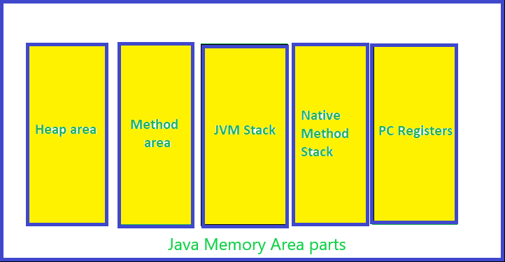
Every method must be declared within a class .
Java provides some pre-defined methods, such as length(),nextInt()..etc, but you can also create your own methods to perform certain actions.
Method data will be stored in stack memory.

Slide 6
Types of methods
There are two types of methods in Java
  User defined
  Predefined

Slide 7
User defined methods
User-defined methods in Java are those methods that are defined inside a class to perform a special task or function in an application. Such methods are called user-defined methods.
A user-defined method is also known as programmer-defined or custom methods method.

Slide 8
Syntax:
modifier returnType nameOfMethod (Parameter List)
{
// method body
}
modifier − It defines the access type of the method and it is optional .
returnType − Data type of the value returned by the method, or void if the method does not return a value.

Slide 9
nameOfMethod −
  Method name can be any valid Identifier
  Method name must be small case, If multiple words it must camel case.
Parameter List − The list of parameters, it is the type, order, and number of parameters of a method. These are optional, method may contain zero parameters.
method body − The method body defines what the method does with the statements. Simply we have to write some business logic here.

Slide 10
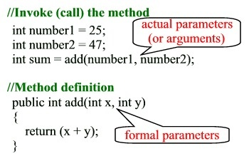

Slide 11
Example:
public class MethodDemo
{
public static void main(String[] args)
{
MethodDemo obj=new MethodDemo();
int sum=obj.getSum(10,20);
System.out.println(sum);
}
public int getSum(int a,int b)
{
int c=a+b;
return c;
}
}

Slide 12
Advantages
It allows code reusability (define once and use multiple times).
You can break a complex program into smaller chunks of code.
It increases code readability.
It reduces no of lines of code in the program.
It eliminates redundant(Duplicate) lines of code
It saves the time and cost of the project

Slide 13
Predefined methods
As the name gives it, predefined methods in Java are the ones that the Java class libraries already define.
This means that they can be called and used anywhere in our program without defining them.
There are numerous predefined methods, such as length(), sqrt(), max(), and print(), and each of them is defined inside their respective classes.

Slide 14
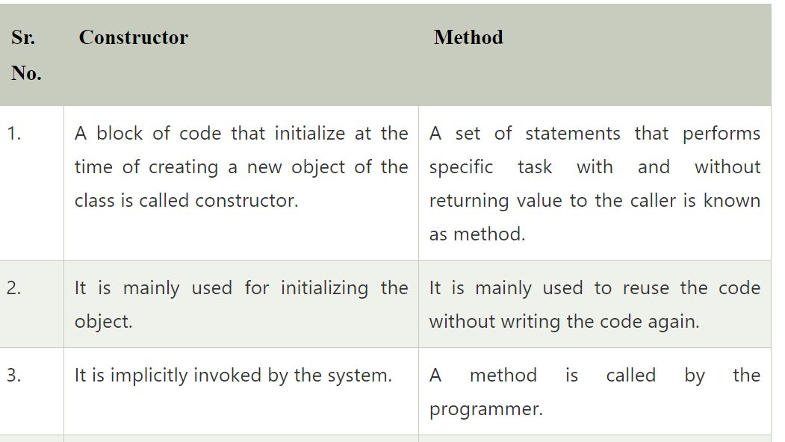

Slide 15
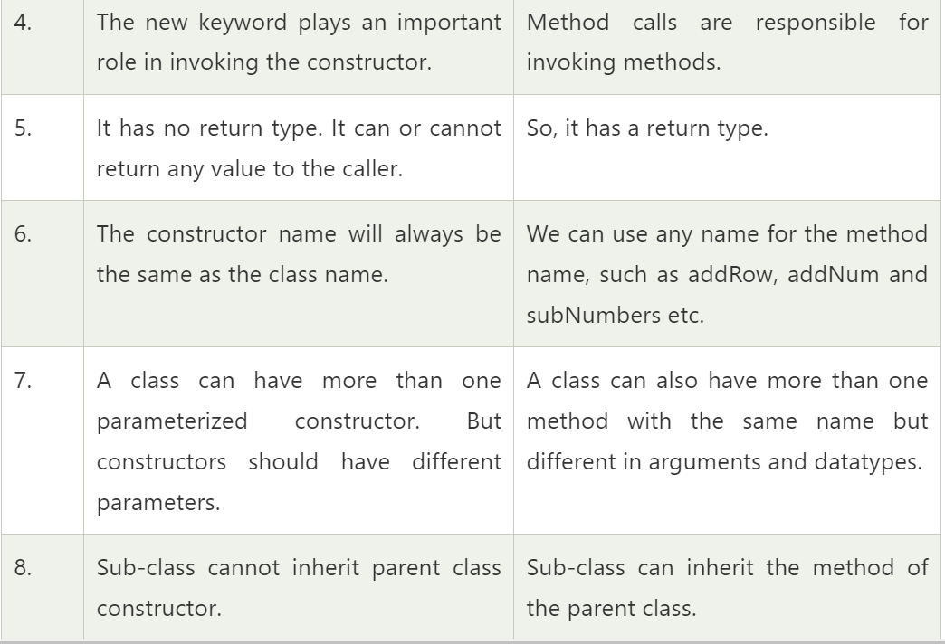

Slide 16

Next….
STATIC BLOCK
Notes:
In Slide Show mode, click the arrow to enter the PowerPoint Getting Started Center.

Slide 17



